Slide 1
Respiration
Monitoring & Analysis

Slide 2
Respiration
Ventilation/Breathing
Movement of air in and out of lungs
External respiration
Gas exchange between air in lungs and blood
Transport of oxygen and carbon dioxide in the blood
Internal respiration
Gas exchange between the blood and tissues

Slide 3
Respiration rate
The respiratory rate (RR), also known as the respiration rate, ventilation rate, ventilatory rate, ventilation frequency (V_{f}),respiration frequency (R_{f}), pulmonary ventilation rate, or breathing frequency, is the rate (frequency) of ventilation, that is, the number of breaths (inhalation-exhalation cycles) taken within a set amount of time (typically 60 seconds). The typical respiratory rate for a healthy adult at rest is 12–20 breaths per minute.

Slide 4
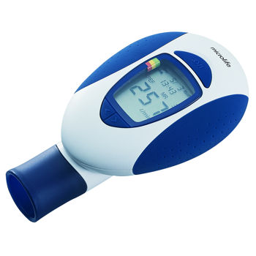
Why is respiration rate an important parameter?
Important Vital Sign
Key indicator of ventilation
Sensitive indicator of physiologic distress
Can indicate respiratory infections and other pulmonary diseases too.
Is essential in hospitals and bed ridden patients
Can alert about Asthma and other respiratory diseases

Slide 5

Current Methods of measuring respiration rate
A) Manual Method
The most common method for respiration rate measurement is by physical assessment, either by counting chest wall movements or by auscultation (listening to internal sounds of the body) of breath sounds with a stethoscope.

Slide 6
Physical Examination or Monitoring
Monitor: Comes from a Latin word, which means “to warn”.
Observation: respiratory rate; pattern; nasal flaring; retractions; accessory muscle use
Auscultation: wheeze; stridor; air entry; crackles/rales (different breath sounds)

Slide 7
Abnormal Patterns of breathing
Pause
Occurs in babies <3 months, resolves by 6 months
Lasts for <3 seconds
Occurs in groups of ≥3, separated by <20 sec
Apnea
NIH Conference consensus statement defines “apnea” as:
Cessation of breathing for longer than 20 seconds or any respiratory pause associated with bradycardia (slower heart rate), pallor (pale skin due to less oxyHb) or cyanosis (blue or purple coloration of skin due to excess of deoxyHb).

Slide 8
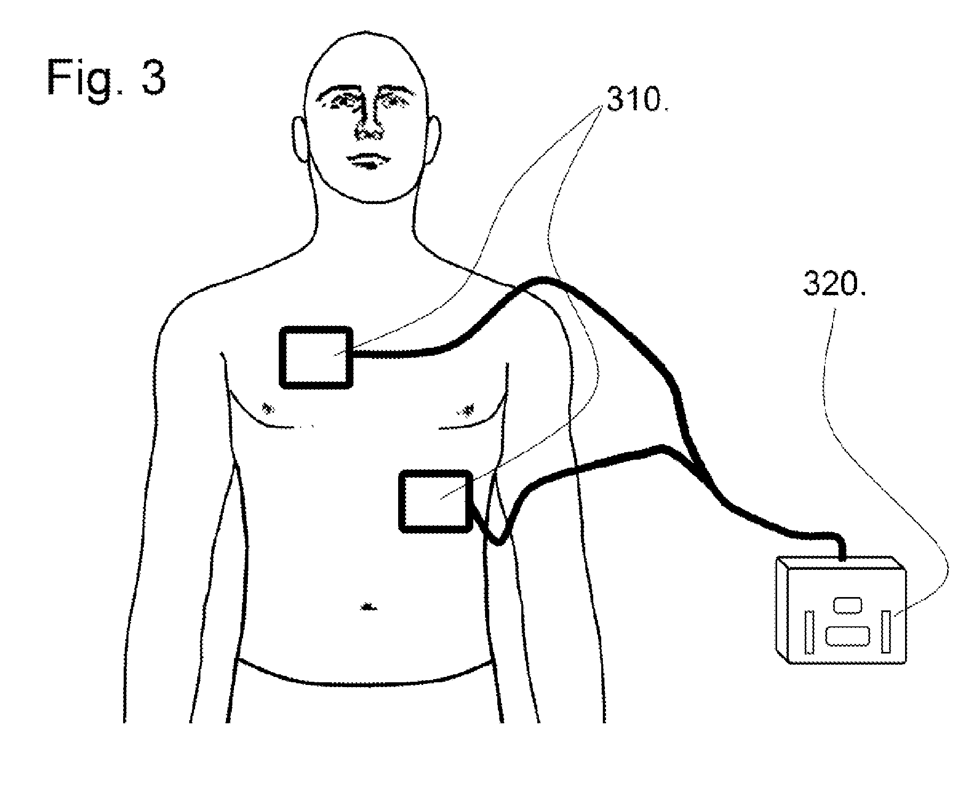
B) Thoracic Impedance Pneumography
(Pneumography: recording velocity and force of chest movements during respiration)
The thoracic chest wall expands and contracts during the respiratory cycle from which respiration rate can be determined by measuring changes in electrical impedance associated with this movement. Impedance is measured by passing a very small alternating current across the chest via ECG Electrodes placed on either side of the chest that measure changes during the respiratory cycle. The respiration rate is then calculated by the repeated cycle of chest wall expansions and contractions.
Notes:
Useful if already Ecg is being done.

Slide 9
Thoracic Impedance Pneumography
3 leads-
1 over the heart
2 on opposite sides of the lower chest
Small current is passed through 1 pair of electrodes
Impedance to current flow varies with the fluid content of the chest which, in turn, varies with the respiratory cycle
Converted into a displayed waveform

Slide 10
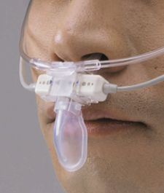
C) Capnography
Capnography is the monitoring of the concentration or partial pressure of carbon dioxide (CO2) in the respiratory gases. Its main development has been as a monitoring tool for use during anesthesia and intensive care.
Usually done via insertion of tubes directly into the respiratory tract.
Since intubated patients have a clear respiratory pattern without entrainment of room air, it is easy for the capnometer to report the respiration rate.
However, capnometers that continuously monitor ventilation for non-intubated patients require a nasal airway cannula that draws a continuous gas sample for spectrographic measurements within the capnometer.

Slide 11
Capnography
Principle:
Capnographs usually work on the principle that CO2 absorbs infra-red radiation. A beam of infra-red light is passed across the gas sample to fall on a sensor. The presence of CO2 in the gas leads to a reduction in the amount of light falling on the sensor, which changes the voltage in a circuit. The analysis is rapid and accurate.Infrared spectroscopy. Compares the amount of infrared light absorbed in a chamber with no CO2.
Factors affecting :
Temp
Pressure
Presence of other gases
Contamination of sample chamber
Calibration

Slide 12
Capnography
Advantages:
No aspiration of liquid (no drawing of any liquids into the respiratory tract via inhalation)
No lag time
No mixing of gases in sample tube
Disadvantages:
Bulky airway adaptor
Must be intubated
Adds dead space
Moisture can contaminate chamber

Slide 13
Capnography
Best if…
Low flow sample rates
Fast response times
Improved moisture handling and purge systems
Calibration and correction for environmental factors

Slide 14
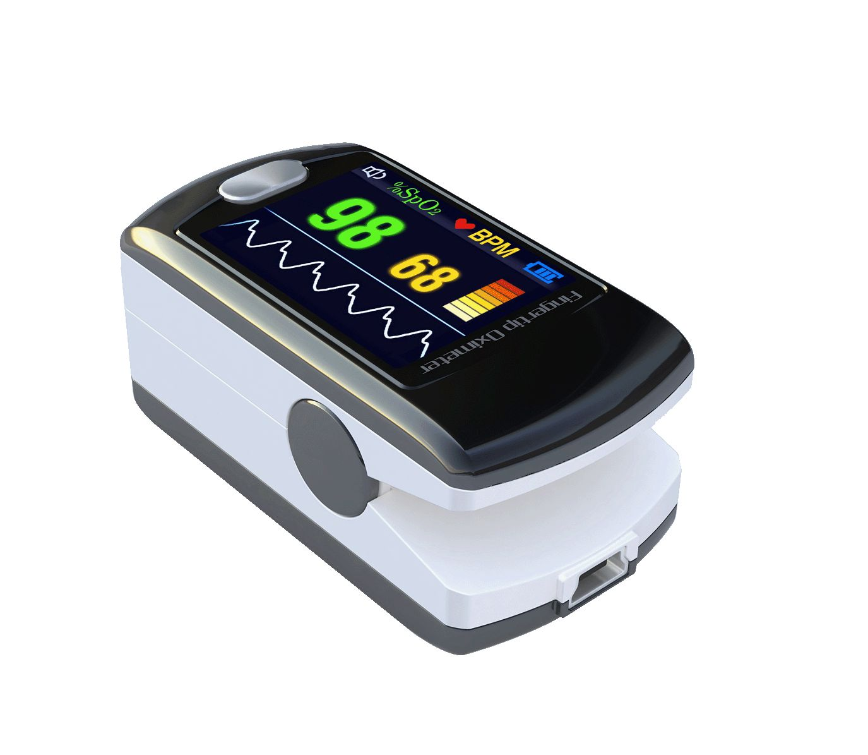
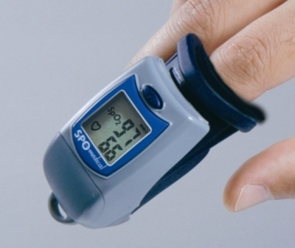
D) Pulse Oximetry

Slide 15
Pulse Oximetry
Non-invasively measures %age of blood Hb saturated with Oxygen, i.e., %HgbO₂
Principle:
Beer-Lambert law: concentration of an unknown solute in a solvent can be determined by light absorption
Wavelengths of 660nm (red) and 940nm (infrared)
Absorption characteristics of the 2 haemoglobins (oxyHB and deoxyHB) are different at these 2 wavelengths

Slide 16
Pulse Oximetry - Mechanics
Light source is applied to an area of the body that is narrow enough to allow light to traverse a pulsating capillary bed and sensed by a photo detector.
Each heartbeat results in a influx of oxygen saturated blood which results in increased absorption of light.
Microprocessor calculates the amounts of HgbO₂ and reduced Hgb to give the saturation.

Slide 17
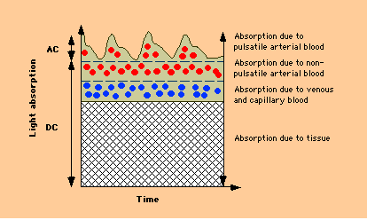

Slide 18
Pulse Oximetry - Problems
Misses other Hgb species (Hgb-CO, Hgb-Met).
Low perfusion states, severe edema (accumulation of fluid) or peripheral vascular disease(may be some blockages in the vessels) make it difficult for the sensor to distinguish the true signal from background.
Increased venous pulsations causes over-estimation of deoxyHb.
Adversely affected by external light sources & motion artifact.

Slide 19
Pulse Oximetry – Anemia Anemia is defined as the reduced conc. Of RBCs or HB in the blood
Hgb 15, Sat 100%
Normal O2 content
Hgb 8, Sat 100%
Decreased O₂ content
Until Hgb<5, then
sampling errors

Slide 20
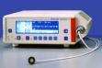
E) Transcutaneous devices (Transcutaneous: measured across depth of skin)
Developed in late 1970’s for use in neonates (newborns)
Electrode is placed on a well-perfused, non-bony surface, skin is warmed to 41-44ºC to facilitate perfusion and allow diffusion of gases.
Estimates partial pressure of O₂ & CO_{2.}
Several studies demonstrated better oxygen correlation with pulse oximetry.

Slide 21
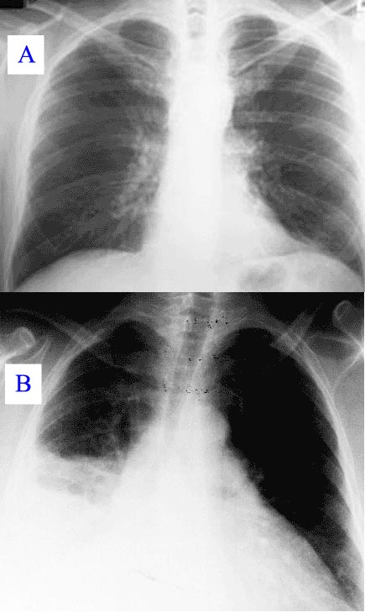
F) Chest X-Ray (CXR)
Several studies in adults and pediatrics show significance of CXR to evaluate ETT (Endotrachial tube)or CVL (central venous line) location.
One study showed that CXR was more sensitive than POx for detecting significant problems.
Routine use with infants or patients being chronic pulmonary ailments.
Pneumonia as seen on chest X-ray. A: Normal chest X-ray. B: Abnormal chest X-ray with consolidation(fluid accumulation) from pneumonia in the right lung

Slide 22
Limitations of existing methods
Manual methods are Intermittent & Unreliable; require intermittent adjustment according to patient needs.
No dynamic measuring
Continuous methods are not accurate or poorly tolerable by patients
Bulky
Not user friendly
Costly
Requirement of specialist to analyze data

Slide 23
Some Modern Devices

Slide 24
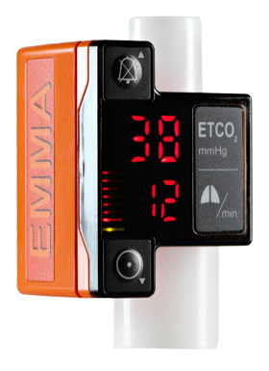
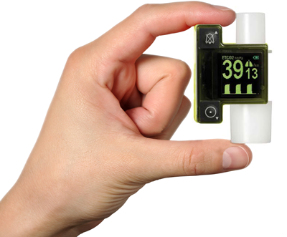
Masimo EMMA Capnometer

Slide 25
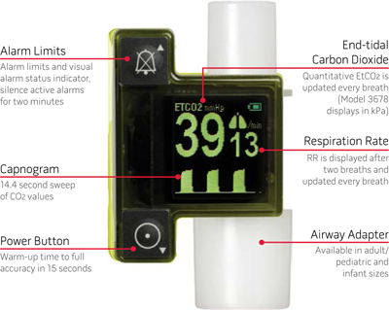

Slide 26
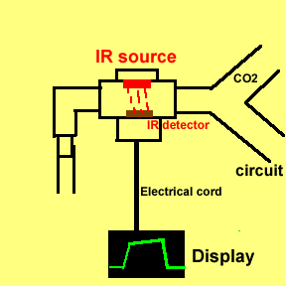

Slide 27
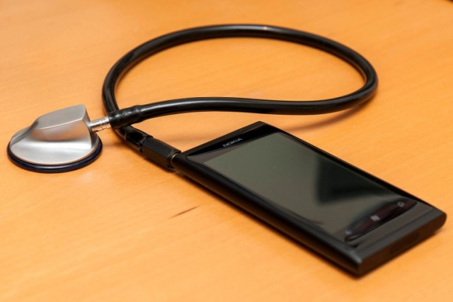
Stetho-cloud
Notes:
Mobile phone- a common commodity

Slide 28
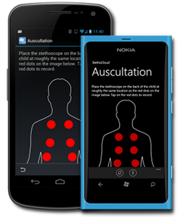
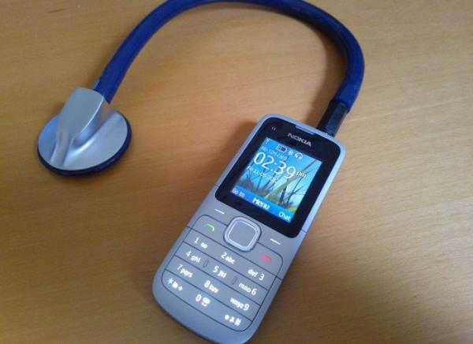

Slide 29
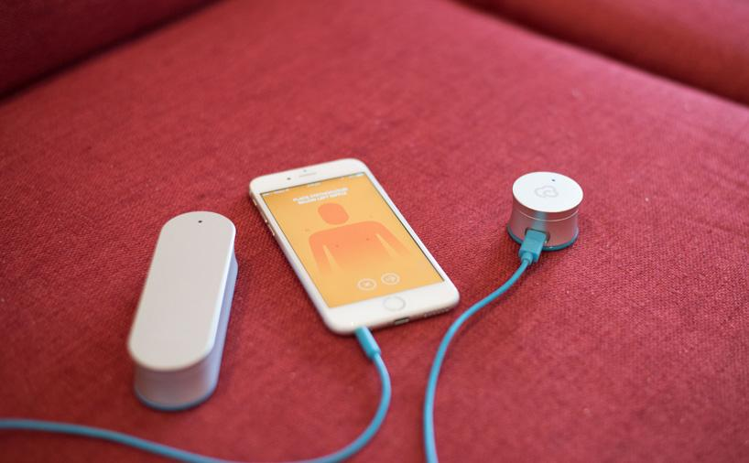
Clinicloud
Notes:
clinicloud

Slide 30
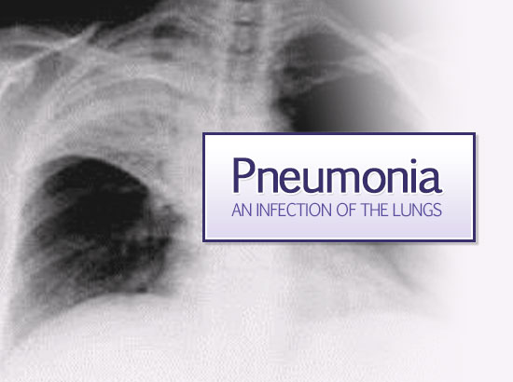
Pneumonia & COPD (Chronic Obstructive Pulmonary disorder)

Slide 31
Some facts
One of the biggest cause of death in children under 5
Diagnosis- one of the biggest issue
Requires an expert to diagnose reliably
Prevalent in low resource settings
Lack of instruments & skilled personnel in such places

Slide 32
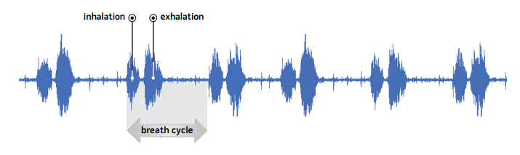
Acoustics of Respiration

Slide 33
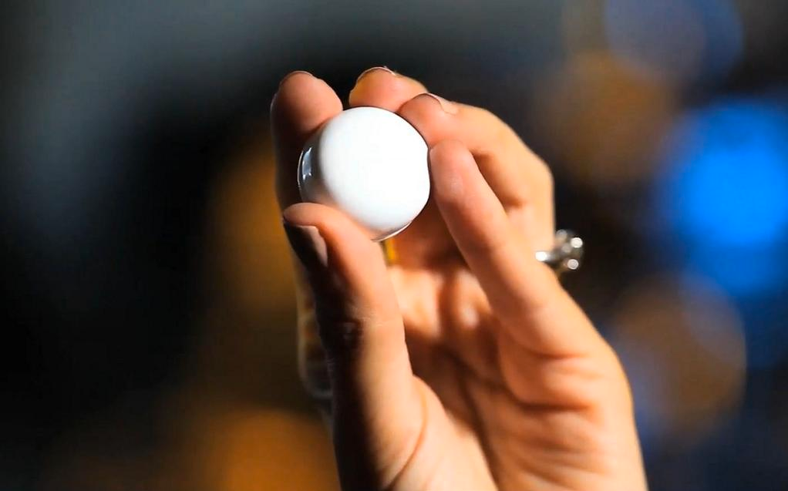
AccuPebble
Notes:
http://www.acupebble.com/

Slide 34
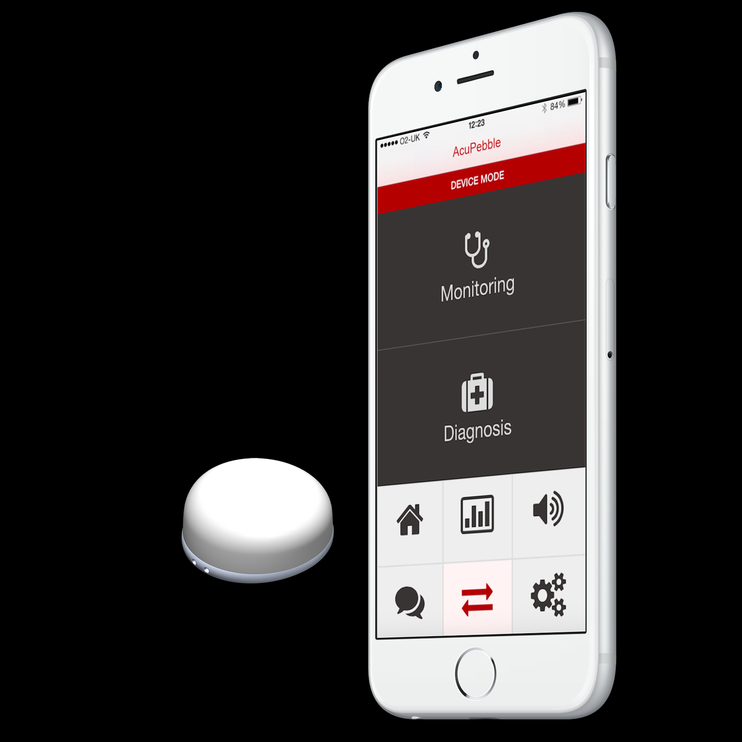

Slide 35
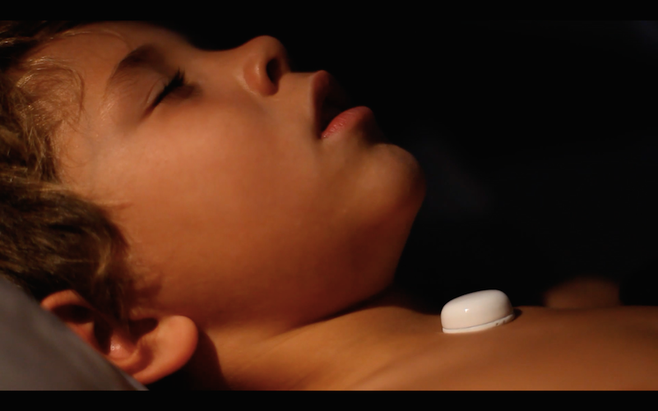

Slide 36
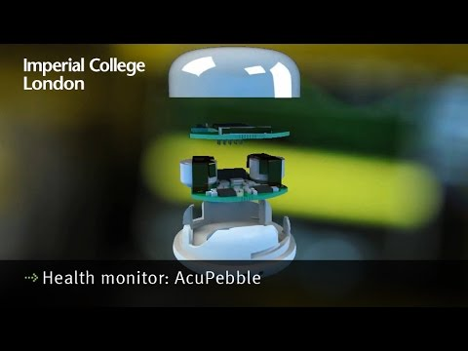

Slide 37
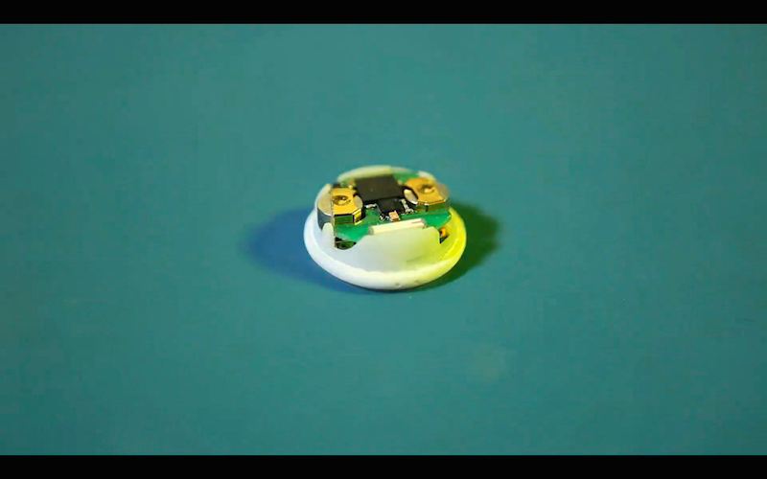
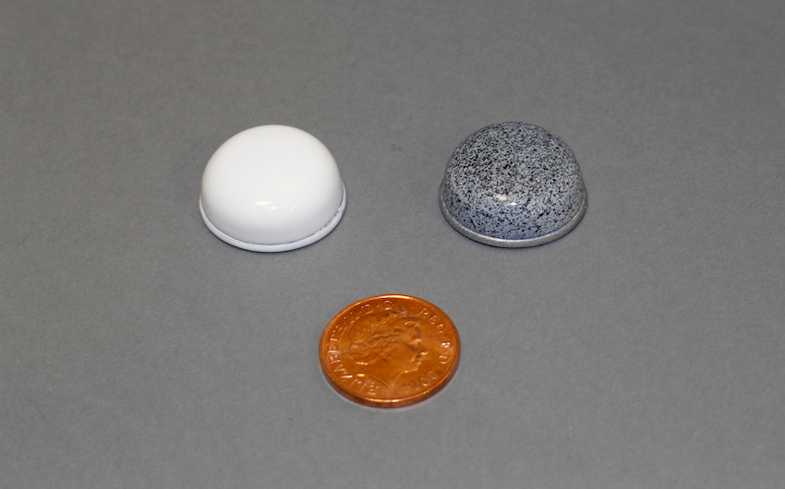

Slide 38

Mint Breathometer
The world’s first smartphone breath analyzer.
Detect and Monitor
Bad breath and Hydration
Alcohol consumption
Future: Could be used to detect drug use?
Notes:
Alcohol detectors
As well as other vitals from breath
(Glucose)

Slide 39
Have any idea?
Or
Enthusiastic about being a part of developing new healthcare and medical technologies?
Drop a mail on:
nanobios.iitb@gmail.com
Or visit us at:
NanoBios Lab
Lab# - 505
5th Floor New BSBE,
Behind New LHC
IIT Bombay.
Tel.022-25767746 / 71
Notes:
We do a lot of constructive brainstorming and prototyping at Nanobios Lab in terms of devices, processes and other technological areas relevant to biology.
To get a gist of what we do and what are we working upon you can drop us a mail or visit our lab after informing in advance.

